Slide 1
Software Project Management
Chapter 6. Selecting a Project Team

Slide 2
4p’s of Project Management?
your project can help your team meet its goals and objectives. The four P’s are :
People
Product
Process
Project

Slide 3
People
Identifying the roles people play in almost any given project is the first step to a successful project. People are the primary resource on every project, and a well-managed team can greatly increase the chances for success

Slide 4
Product
As the name suggests, this is the deliverable of the project. The project manager should define the product scope to ensure a successful outcome, control “scope creep”; as well as technical hurdles that he or she may encounter.

Slide 5
Process
The third P of project management is Process. Project managers and team members should have a methodology and plan that outlines their approach. Without a clearly defined process, team members will not know what to do and when to carry out project activities.

Slide 6
Project
The fourth and final P of project management is Project. This is where the project manager’s roles and responsibilities come into play. He or she must guide team members to achieve the project’s goals and objectives.
The project manager must delegate tasks, help team members when needed, and ultimately strive to accomplish all requirements set forth in the project scope.

Slide 7
Selecting a Project Team
The selection of a project team occurs early in the life cycle of a software development project.
The selection of team members, the stages of team building that occur, and the way in which the team transforms all support and affect the remainder of the activities in the life cycle.
Many project teams exhibit behavioral characteristics of a single personality. Some are productive, some are seemingly dysfunctional, and others exhibit wide mood swings.

Slide 8
Where We Are in the Product Development Life Cycle
The selection and formation of a project team supports the entire life cycle and is therefore important to every phase, but the first team formation occurs early in the project.

Slide 9
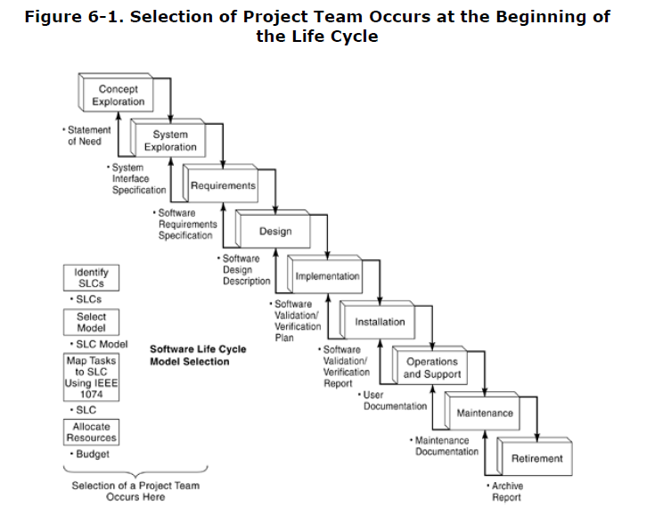

Slide 10
The Whole Is the Sum of the Parts
The personality of a project is comprised of individuals who, in turn, have complex personalities. Taibi Kahler suggests, Observing people is like observing holograms.
A hologram consists of hundreds of thousands of independent images, each of which portrays a complete object from a slightly different angle.
A PM key skill, often unnatural among technical leaders, is the ability to recognize the mix of personalities that a project team possesses and maximize that mix for productivity.
A team is made up of independent images, just as is each person.

Slide 11
Individual Personality Type
Starting with the individual, several personality models have been derived from Carl Jung's theory of "psychological types. That are:
The Myers-Briggs Type Indicator (MBTI)
The Fundamental Interpersonal Relations Orientation Behavior (FIRO-B) model
The Keirsey Temperament Sorter, the Kahler Process Communication Model (PCM)

Slide 12
Myers-Briggs Type Indicator
The Myers-Briggs Personality Type Indicator may be the most popular and widespread, having been in use for more than 40 years.
MBTI identifies four bipolar dimensions of behavior, measuring self-reported preferences on each one, which allows different personality descriptions, identified by 4-letter codes.

Slide 13
